Slide 1
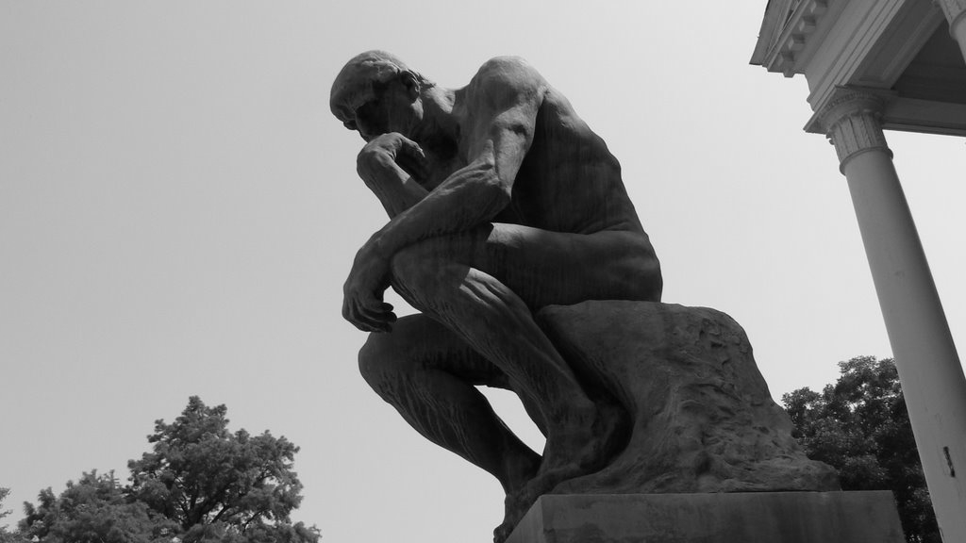


THINKING AND ANALYSIS (cont.)

Slide 2
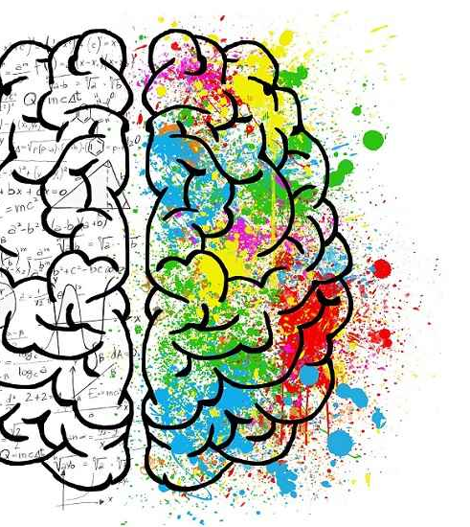
Chapter outlines
THINKING AND ANALYSIS
4. Critical Thinking Skills
Notes:
Pattern /ˈpæt̬.ɚn/:

Slide 3
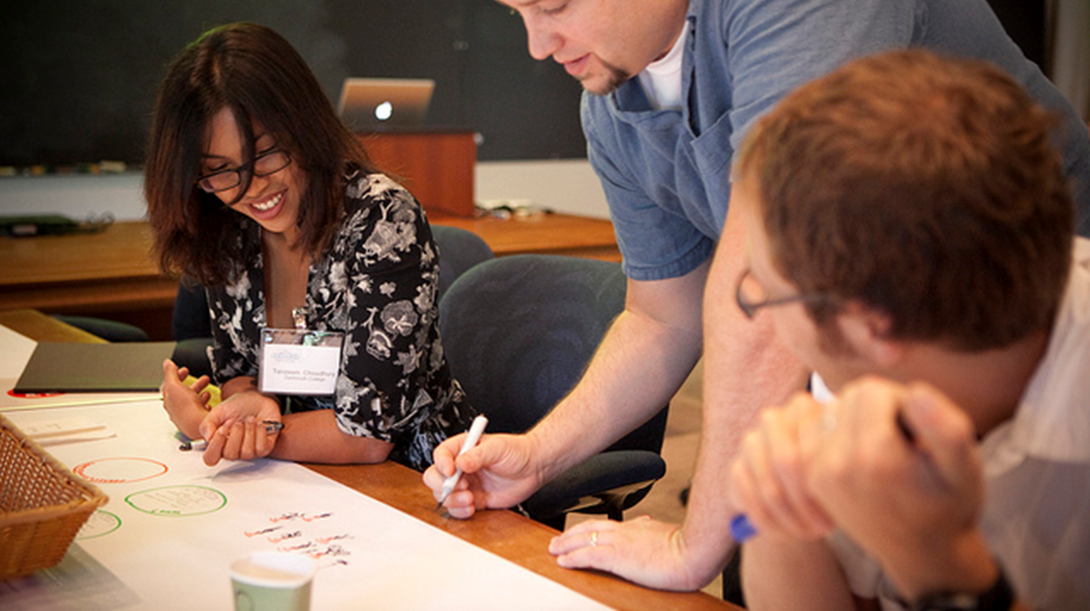
Critical Thinking Skills
“The essence of the independent mind lies not in what it thinks, but in how it thinks.”
Christopher Hitchens, author and journalist

Slide 4

LEARNING OBJECTIVES
By the end of this section, you will be able to:
Define critical thinking
Describe the role that logic plays in critical thinking
Describe how critical thinking skills can be used to problem-solve
Describe how critical thinking skills can be used to evaluate information
Identify strategies for developing yourself as a critical thinker.

Slide 5

What Is Critical Thinking?
Critical thinking is clear, reasonable, reflective thinking focused on deciding what to believe or do.
It involves being skeptical and challenging assumptions, rather than simply memorizing facts or blindly accepting what you hear or read.
Asking probing questions like:
“How do we know?”
“Is this true in every case or just in this instance?”
Notes:
Skeptical /ˈskep.tɪ.kəl/ doubting that something is true or useful
Probing /ˈproʊ.bɪŋ/ intended to get information

Slide 6
Critical Thinking IS | Critical Thinking is NOT
Skepticism | Memorizing
Examining assumptions | Group thinking
Challenging reasoning | Blind acceptance of authority
Uncovering biases

Slide 7
ACTIVITY: SELF-ASSESS YOUR CRITICAL THINKING STRATEGIES
Objectives
Assess your basic understanding of the skills involved in critical thinking.
Directions
Visit the Quia Critical Thinking Quiz page and click on Start Now (you don’t need to enter your name). Select the best answer for each question, and then click on Submit Answers. A score of 70 percent or better on this quiz is considering passing.
Based on the content of the questions, do you feel you use good critical thinking strategies in college? In what ways might you improve as a critical thinker?

Slide 8
Critical Thinking and Logic
Critical thinking is fundamentally a process of questioning information and data.
You may question the information you read in a textbook, or you may question what a politician or a professor or a classmate says. You can also question a commonly-held belief or a new idea.
With critical thinking, anything and everything is subject to question and examination for the purpose of logically constructing reasoned perspectives.

Slide 9
What Is Logic, and Why Is It Important in Critical Thinking?
The word logic comes from the Ancient Greek “logike”, referring to the science or art of reasoning.
Using logic, a person evaluates arguments and reasoning and strives to distinguish between good and bad reasoning, or between truth and falsehood.
Using logic, you can evaluate ideas or claims people make, make good decisions, and form sound beliefs about the world.

Slide 10
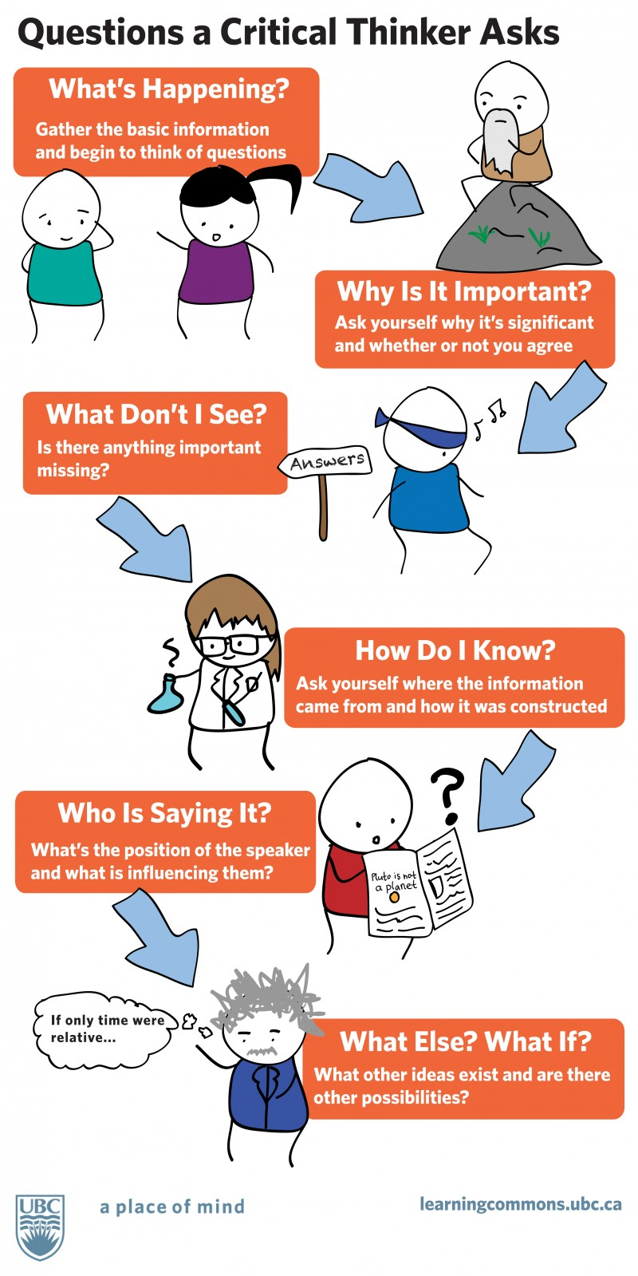
Questions of Logic in Critical Thinking
What’s happening? Gather the basic information and begin to think of questions.
Why is it important? Ask yourself why it’s significant and whether or not you agree.
What don’t I see? Is there anything important missing?
How do I know? Ask yourself where the information came from and how it was constructed.
Who is saying it? What’s the position of the speaker and what is influencing them?
What else? What if? What other ideas exist and are there other possibilities?

Slide 11


Problem-Solving with Critical Thinking
Critical thinking and problem-solving go hand-in-hand
Refer to using knowledge, facts, and data to solve problems effectively.

Slide 12
Examples of using critical thinking to problem-solve
Your classmate was upset and said some unkind words to you, which put a crimp in the relationship. You try to see through the angry behaviors to determine how you might best support the roommate and help bring the relationship back to a comfortable spot.
Your campus club has been languishing on account of lack of participation and funds. The new club president, though, is a marketing major and has identified some strategies to interest students in joining and supporting the club. Implementation is forthcoming.
Your math teacher sees that the class is not quite grasping a concept. She uses clever questioning to dispel anxiety and guide you to new understanding of the concept.

Slide 13
Problem-Solving Action Checklist
STRATEGIES | ACTION CHECKLIST
1. Define the problem | Identify the problem Provide as many supporting details as possible Provide examples Organize the information logically
2. Identify available solutions | Use logic to identify your most important goals Identify implications and consequences Identify facts Compare and contrast possible solutions
3. Select your solution | Use gathered facts and relevant evidence Support and defend solutions considered valid Defend your solution

Slide 14
Evaluating Information with Critical Thinking
Evaluating information can be one of the most complex tasks.
But if you utilize the following four strategies, you will be well on your way to success:
Read for understanding by using text coding
Examine arguments
Clarify thinking
Cultivate “habits of mind”

Slide 15
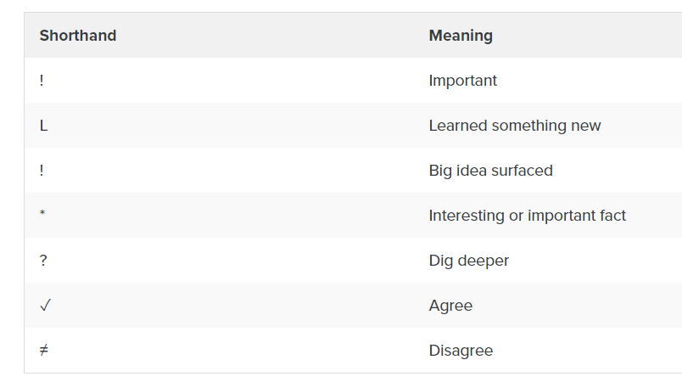
A. Read for Understanding Using Text Coding
Text coding is a way of tracking your thinking while reading
With text coding, mark important arguments and key facts
See more text coding from PBWorks and Collaborative for Teaching and Learning.

Slide 16
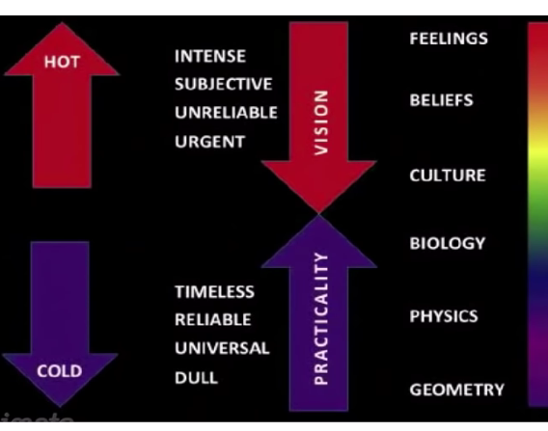
B. Examine Arguments
Use the spectrum of authority strategy
https://youtu.be/9G5xooMN2_c

Slide 17
C. Clarify Thinking
When you use critical thinking to evaluate information, you need to clarify your thinking to yourself and likely to others.
What is the purpose?
What question are we trying to answer?
What point of view is being expressed?
What assumptions are we or others making?

Slide 18
C. Clarify Thinking (cont.)
When you use critical thinking to evaluate information, you need to clarify your thinking to yourself and likely to others.
What are the facts and data we know, and how do we know them?
What are the concepts we’re working with?
What are the conclusions, and do they make sense?
What are the implications?

Slide 19

D. Cultivate “Habits of Mind”
“Habits of mind” are the personal commitments, values, and standards you have about the principle of good thinking.
Do you approach problems with an open mind, a respect for truth, and an inquiring attitude?

Slide 20
Try to work these qualities into your daily life:
Being receptive to having your opinions changed
Having respect for others
Being independent
Not accepting something is true until you’ve had the time to examine the available evidence

Slide 21
Try to work these qualities into your daily life:
Being fair-minded
Having respect for a reason
Having an inquiring mind
Not making assumptions
Questioning your own conclusions

Slide 22
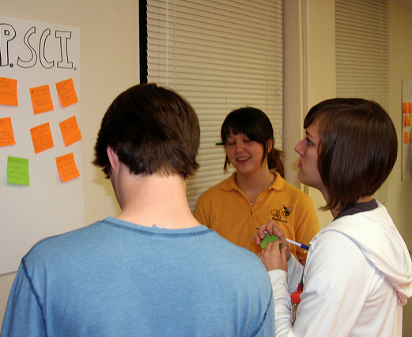
Developing Yourself As a Critical Thinker
Reflect and practice
Use wasted time
Redefine the way you see things
Analyze the influences on your thinking and in your life
Express yourself
Enhance your wellness

Slide 23
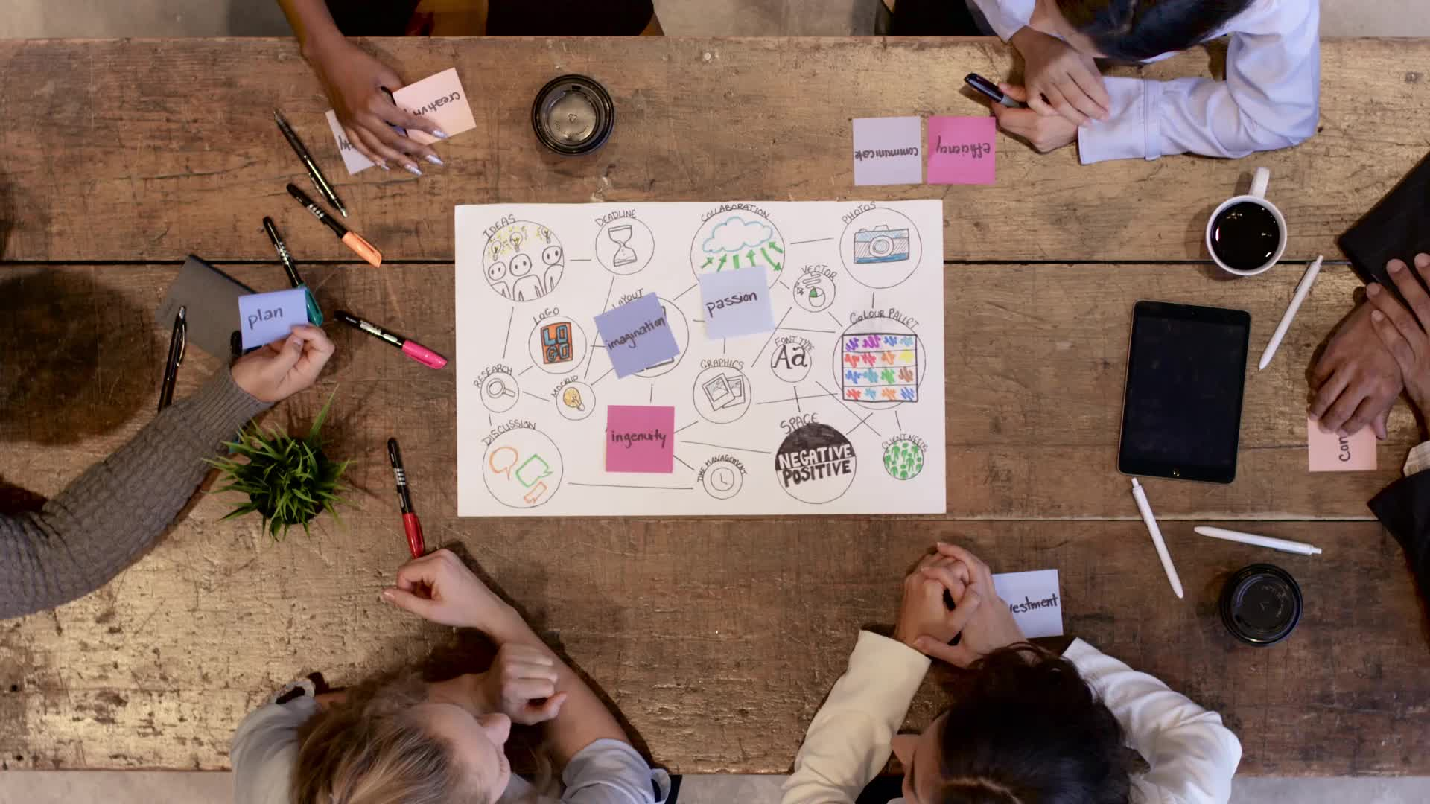
Practice: Evaluation of project ideas "Social Initiatives"
Use critical thinking skills to challenge other groups' social initiatives ideas (from activity 1 of Creative Thinking Skills)
Point out weaknesses and difficulties in implementing ideas in life

Slide 24


